Slide 1

H1b visa data analysis
USING HADOOP FRAMEWORK
BY: SACHIN CHHARIA
ID: S180020200176

Slide 2

Some of the reasons why big data is generating:
NEW TECHNOLOGIES
NEW DEVICES
COMMUNICATION MEANS-SOCIAL NETWORKING SITES

Slide 3

FIELDS THAT COME UNDER BIGDATA:
SEARCH ENGINE DATA
BANK DATA
BLACKBOX DATA
AVIATION DATA
STOCK EXCHANGE DATA
SECURITY DATA
SOCIAL MEDIA DATA

Slide 4
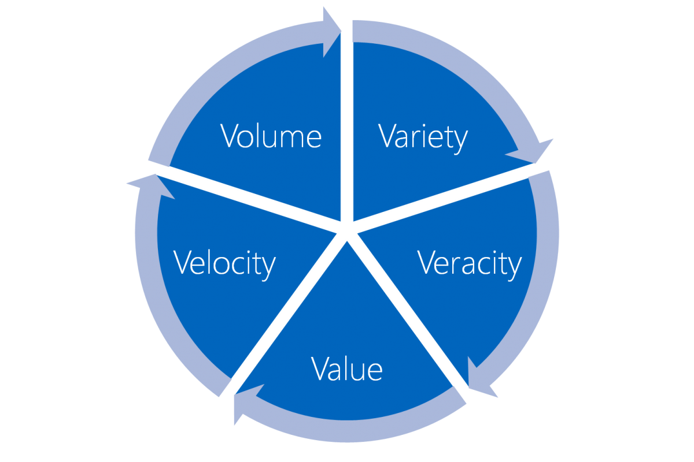
BIG DATA INCLUDES 5 Vs
TYPES OF DATA
STRUCTURED DATA
UNSTRUCTURED DATA
SEMI STRUCTURED DATA

Slide 5
IMPORTANCE OF BIG DATA:
Cost reductions and Time reduction
New product development and optimized offerings
Smart decision making.
Determining root causes of failures, issues and defects in near-real time.
Generating coupons at the point of sale, based on the customer’s buying habits.
Detecting fraudulent behaviour before it affects the organization.

Slide 6

What is Apache Hadoop?
Open source software framework designed for storage and processing of large scale data on clusters of commodity hardware
Created by Doug Cutting and Mike Carafella in 2005.
Cutting named the program after his son’s toy elephant.

Slide 7
The Hadoop Ecosystem
Hadoop Common
Contains Java Libraries and utilities used by other modules
HDFS
Hadoop Distributed File System
Hadoop YARN
Yet Another Resource Negotiator
Hadoop MapReduce
A YARN based programming model for processing large sets.

Slide 8
HDFS(Hadoop distributed file system)
HDFS is a file system written in Java based on the Google’s GFS
Runs on commodity hardware.
HDFS is highly fault tolerant and designed using low-cost hardware.
HDFS holds very large amount of data and provides easier access.
Files are stored in redundant fashion to rescue the system from possible data losses in case of failure.

Slide 9

HDFS ARCHITECTURE

Slide 10
MapReduce Overview
A method for distributing computation across multiple nodes
Each node processes the data that is stored at that node
Consists of two main phases
1.Map
2.Reduce

Slide 11
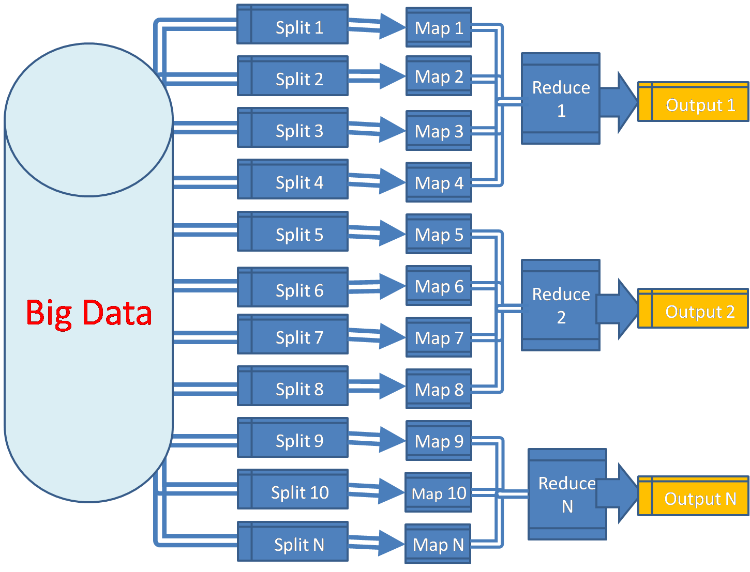

Slide 12
The Mapper
SORT AND SHUFFLE
The REDUCER
Reads data as key/value pairs
The key is often discarded
Outputs zero or more key/value pairs
Output from the mapper is sorted by key
All values with the same key are guaranteed to go to the same machine
The Reducer code reads the outputs generated by the different mappers as pairs and emits key value pairs.
The reducer outputs zero or more final key/value pair.

Slide 13
Project Prerequisites:
The H1B data is in CSV format and hence needs to be converted in TEXT format in Hadoop file system.
For that we use HIVE.
We have a hive built-in function to convert CSV data to TEXT format.

Slide 14
THANK YOU

